Slide 1
18CSE487T
Data Warehousing and its Applications
UNIT-2

Slide 2
Data warehouse Dimensional Data Modeling
Dimensional Data Modeling is one of the data modeling techniques used in data warehouse design.
The concept of Dimensional Modeling was developed by Ralph Kimball which is comprised of facts and dimension tables.
Since the main goal of this modeling is to improve the data retrieval so it is optimized for SELECT OPERATION.
The advantage of using this model is that we can store data in such a way that it is easier to store and retrieve the data once stored in a data warehouse.
The dimensional model is the data model used by many OLAP systems.

Slide 3
Facts
Facts are the measurable data elements that represent the business metrics of interest.
For example, in a sales data warehouse, the facts might include sales revenue, units sold, and profit margins.
Each fact is associated with one or more dimensions, creating a relationship between the fact and the descriptive data.

Slide 4
Dimensions
Dimensions are the descriptive data elements that are used to categorize or classify the data.
For example, in a sales data warehouse, the dimensions might include product, customer, time, and location.
Each dimension is made up of a set of attributes that describe the dimension.
For example, the product dimension might include attributes such as product name, product category, and product price.

Slide 5
Data warehouse Schema
Schema is a logical description of the entire database.
It includes the name and description of records of all record types including all associated data-items and aggregates.
Much like a database, a data warehouse also requires to maintain a schema.
A database uses relational model, while a data warehouse uses
Star,
Snowflake, and
Fact Constellation schema.

Slide 6
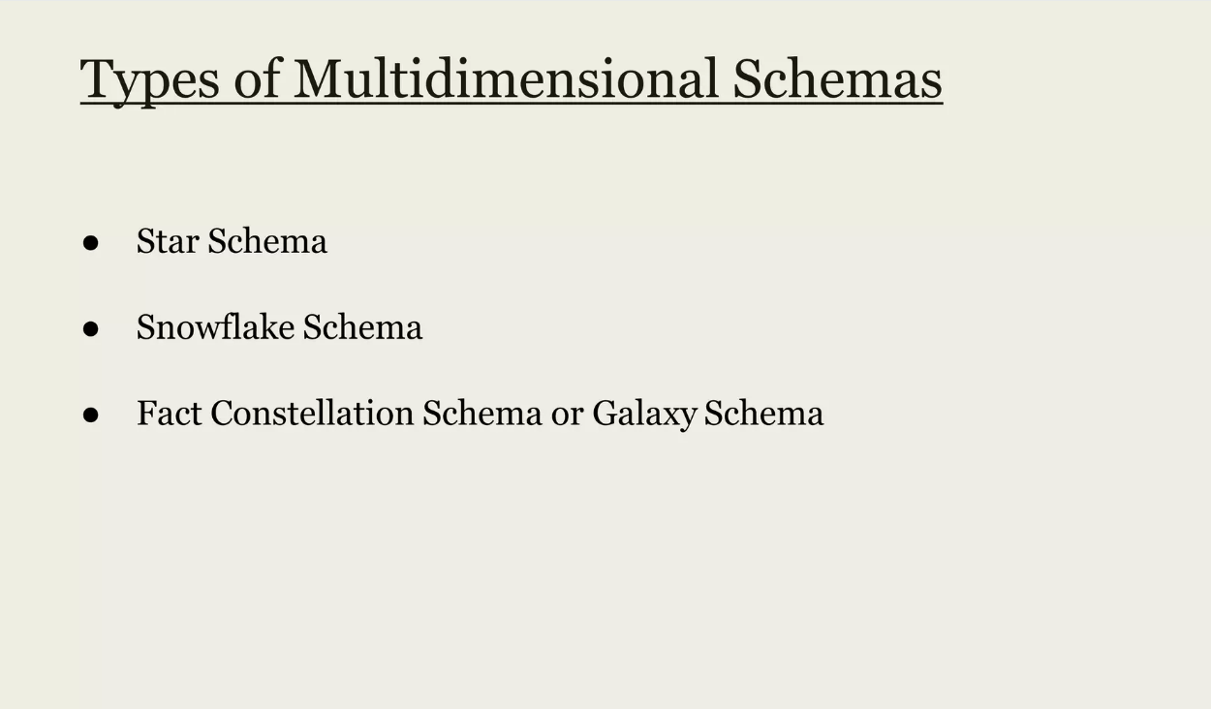
Data warehouse Schema

Slide 7
Star Schema
Simplest type of Data Warehouse Schema.
Structure resembles like a star.
Each dimension in a star schema is represented with only one-dimension table.
This dimension table contains the set of attributes.
There is a fact table at the center. It contains the keys to each of four dimensions.
The following diagram shows the sales data of a company with respect to the four dimensions, namely time, item, branch, and location.

Slide 8
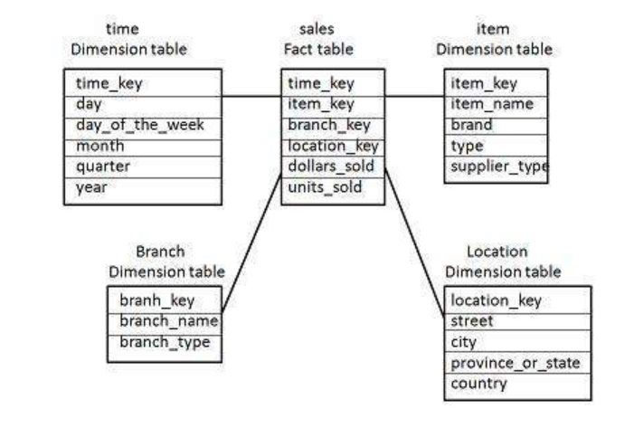
Star Schema

Slide 9
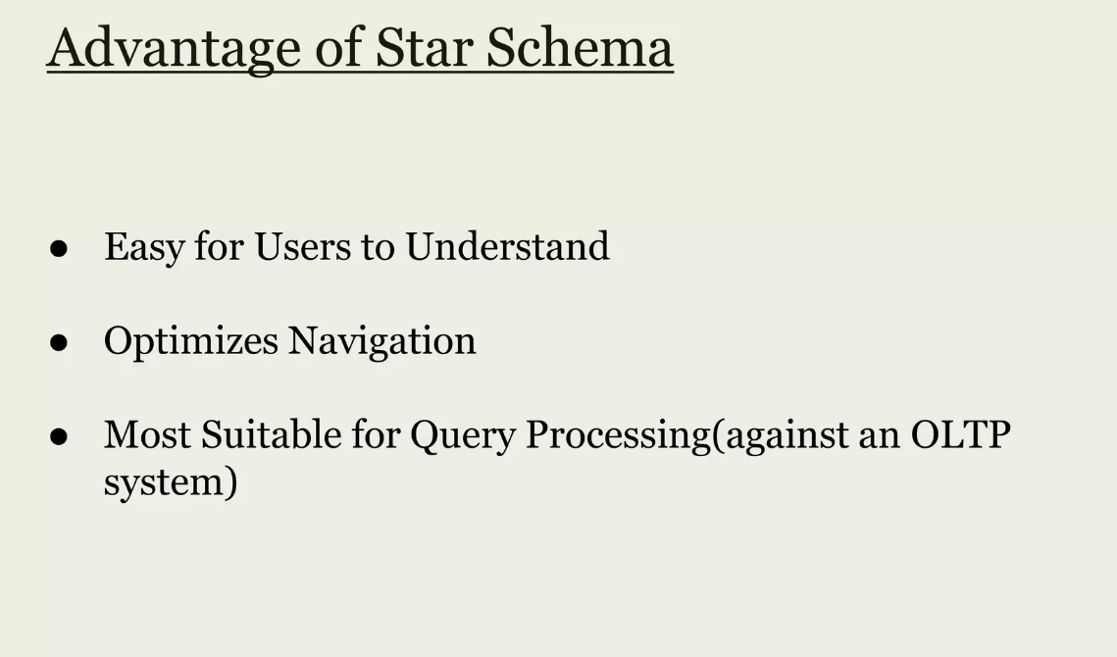

Slide 10
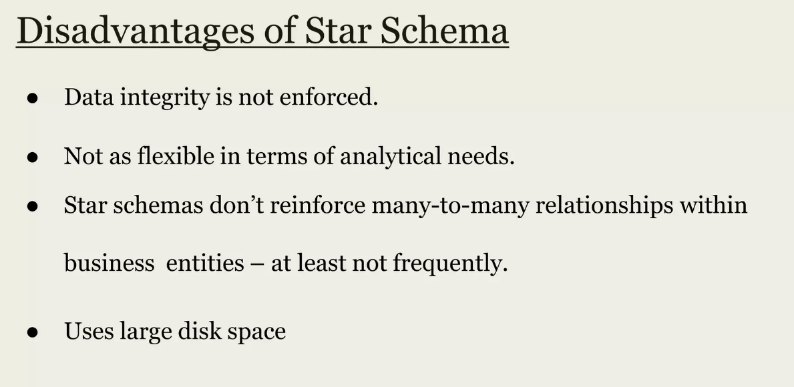

Slide 11
Snowflake Schema
Some dimension tables in the Snowflake schema are normalized.
The normalization splits up the data into additional tables.
Unlike Star schema, the dimensions table in a snowflake schema are normalized.
For example, the item dimension table in star schema is normalized and split into two dimension tables, namely item and supplier table.

Slide 12
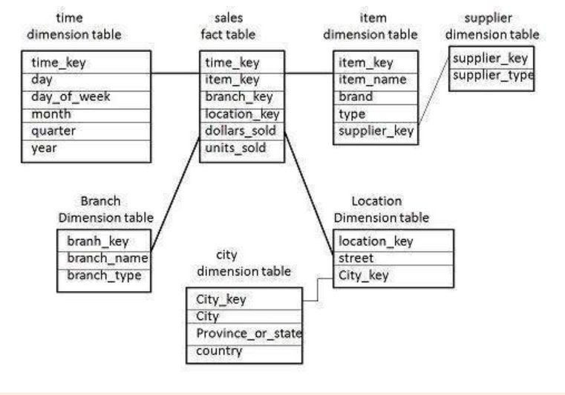
Snowflake Schema

Slide 13
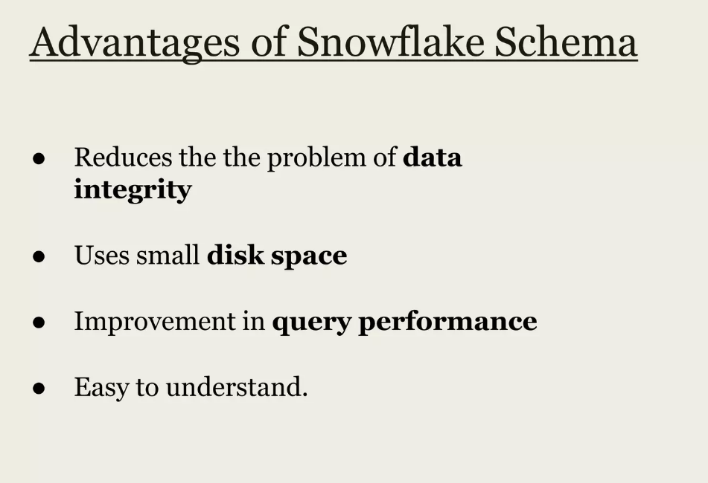

Slide 14
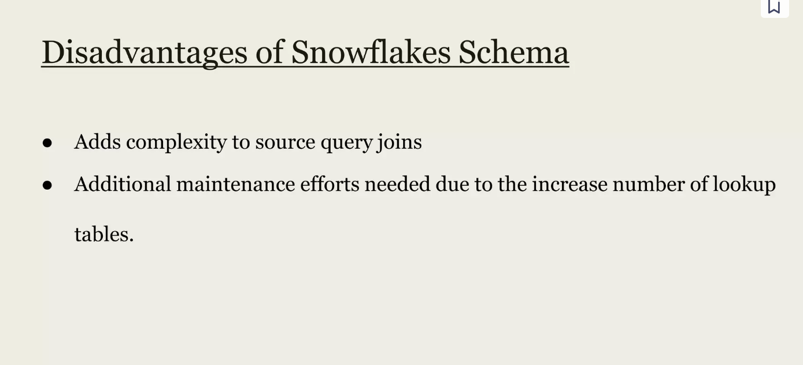

Slide 15
Fact Constellation Schema
A fact constellation has multiple fact tables. It is also known as galaxy schema.
Combines other two schemas.

Slide 16
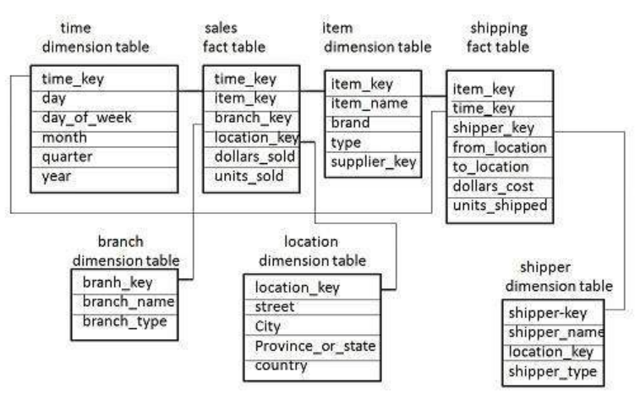
Fact Constellation Schema

Slide 17
Fact Constellation Schema
The sales fact table is same as that in the star schema.
The shipping fact table has the five dimensions, namely item_key, time_key, shipper_key, from_location, to_location.
The shipping fact table also contains two measures, namely dollars sold and units sold.
It is also possible to share dimension tables between fact tables. For example, time, item, and location dimension tables are shared between the sales and shipping fact table.

Slide 18
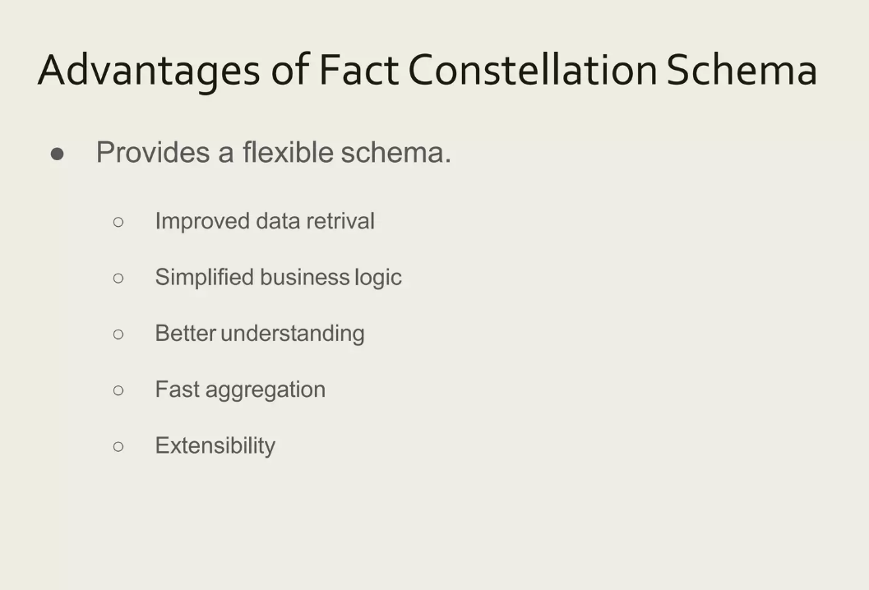

Slide 19
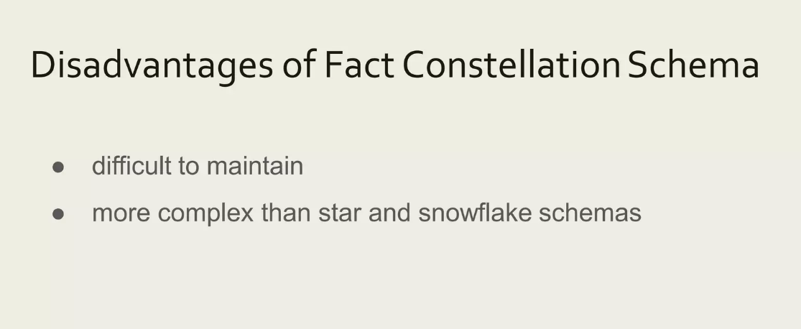

Slide 20
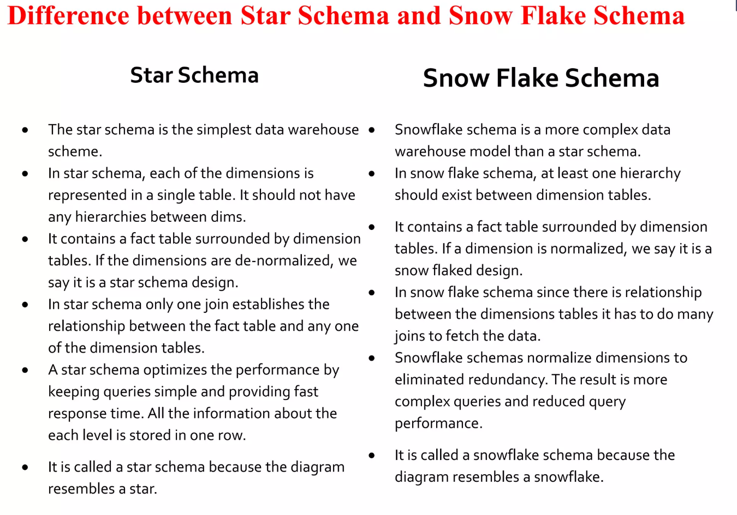

Slide 21
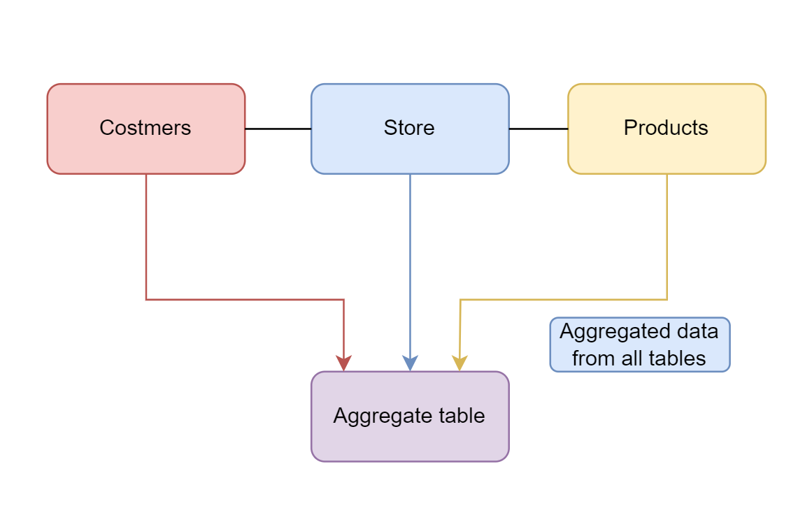
Aggregate Table
Aggregate tables contain aggregated data that are precalculated summaries derived from fact tables.

Slide 22
Why do we use aggregate tables?
A query in simple systems provides results for a single use case, such as when dealing with a single student, a single customer, and so on.
On the other hand, in a data warehouse, a query generates large result sets.
Let’s suppose we want to retrieve data from multiple tables using a query in which we do some mathematical calculations.
Since we have a large amount of data, it may take some time.
To make it faster and more reliable, we create an aggregate table in which aggregated data is provided.

Slide 23
Uses of data aggregation
It helps organizations achieve their business objectives.
It helps with the statistical analysis of groups of people.
Data aggregation can help improve our marketing.
It also helps in improving our sales and purchases.

Slide 24
Data Extraction
Data extraction is the process of collecting or retrieving disparate types of data from a variety of sources, many of which may be poorly organized or completely unstructured. Data
extraction makes it possible to consolidate, process, and refine data so that it can be stored in a centralized location in order to be transformed. These locations may be on-site, cloud-based, or a hybrid of the two.

Slide 25
Data Extraction
Data extraction is the first step in both ETL (extract, transform, load) and ELT (extract, load, transform) processes.
ETL/ELT are themselves part of a complete data integration strategy

Slide 26
Data Extraction and ETL
ETL allows companies and organizations to
1) consolidate data from different sources into a centralized location and
2) assimilate different types of data into a common format.
There are three steps in the ETL process:
Extraction
Transformation
Loading

Slide 27
ETL
Extraction :
Data is taken from one or more sources or systems. The extraction locates and identifies relevant data, then prepares it for processing or transformation. Extraction allows many different kinds of data to be combined and ultimately mined for business intelligence.
2. Transformation
Once the data has been successfully extracted, it is ready to be refined. During the transformation phase, data is sorted, organized, and cleansed.
For example, duplicate entries will be deleted, missing values removed or enriched, and audits will be performed to produce data that is reliable, consistent, and usable
3. Loading
The transformed, high quality data is then delivered to a single, unified target location for storage and analysis.

Slide 28
Benefits of Using an Extraction Tool
More control.
Increased agility.
Simplified sharing.
Accuracy and precision

Slide 29
Types of Data Extraction
Customer Data: .
Financial Data
Use, Task, or Process Performance Data.
figuring out where you can get it
Deciding where you want to store it.

Slide 30
Data transformation: Basic tasks
Data Transformation
Data transformation is the process in which data gets converted from one format to another.
The most common data transformation process involves collecting raw data and converting it into clean, usable data.

Slide 31
Data transformation: Basic tasks
Data transformation increases the efficiency of business and analytic processes.
It enables businesses to make better data-driven decisions.
During the data transformation process, an analyst will determine the structure of the data

Slide 32
Data transformation may be
Constructive: The data transformation process adds, copies, or replicates data.
Destructive: The system deletes fields or records.
Aesthetic: The transformation standardizes the data to meet requirements or parameters.
Structural: (Renaming, moving, and combining columns in a database)

Slide 33
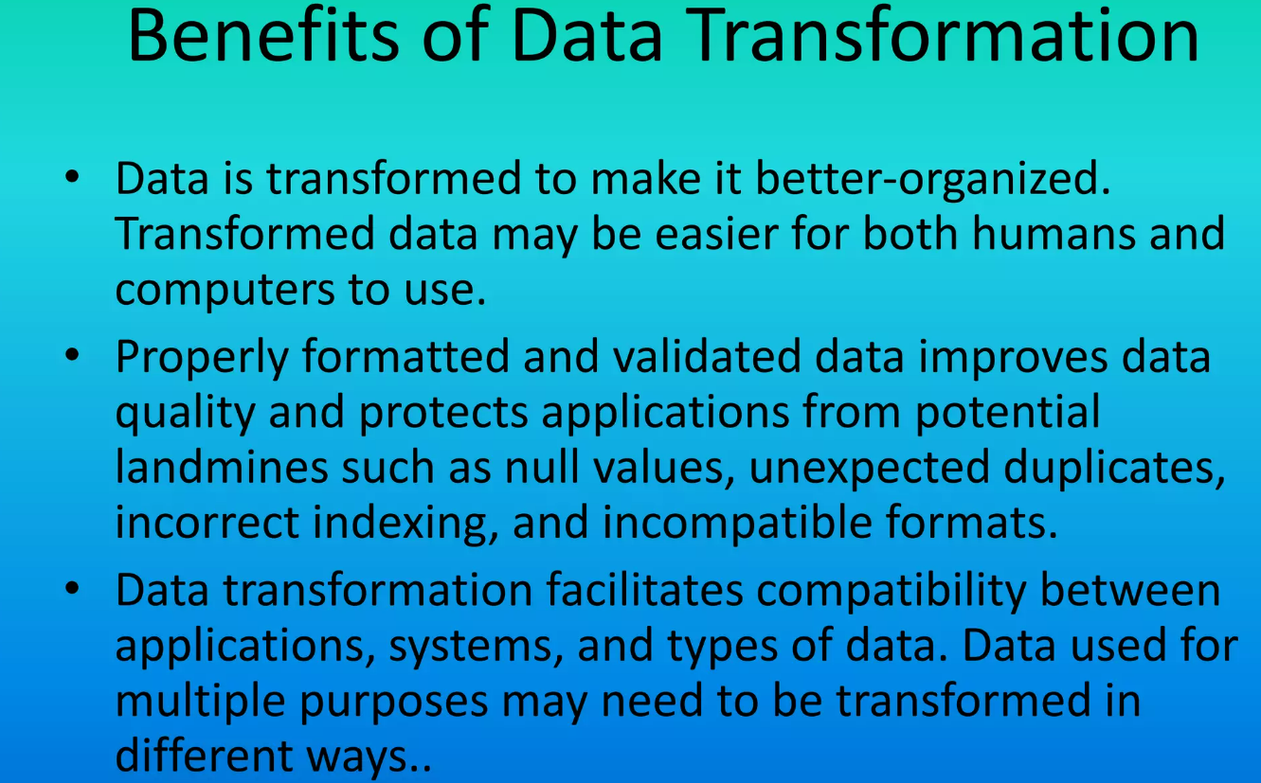
Data Transformation

Slide 34
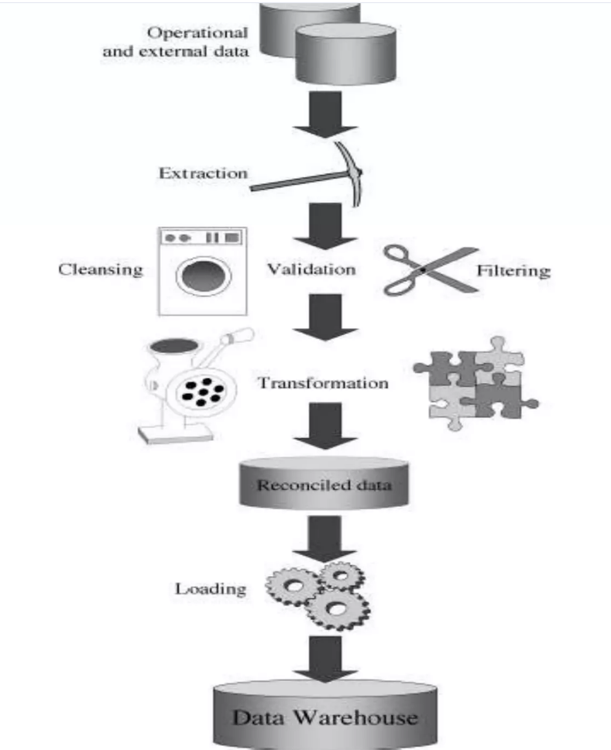
Data Transformation

Slide 35
Data Transformation
Transformation may tasks vary based on the application:
Major Tasks are:
Selection
Splitting/ Joining
Conversion
Summarization
Enrichment

Slide 36
Data Transformation
Selection:
This takes place at the beginning of the whole process of data transformation.
Select either whole records or parts of several records from the source systems.
The task of selection usually forms part of the extraction function itself.

Slide 37
Data Transformation
2. Splitting/ Joining
This task includes the types of data manipulation you need to perform on the selected parts of source records.
Sometimes (uncommonly), you will be splitting the selected parts even further during data transformation.
Joining of parts selected from many source systems is more widespread in the data warehouse environment

Slide 38
Data Transformation
3. Conversion
This is an all-inclusive task. It includes a large variety of rudimentary conversions of single fields for two primary reasons
to standardize among the data extractions from disparate source systems, and
to make the fields usable and understandable to the users.

Slide 39
Data Transformation
4. Summarization
Sometimes it is not feasible to keep data at the lowest level of detail in your data warehouse.
It may be that none of your users ever need data at the lowest granularity for analysis or querying.
For example, for a grocery chain, sales data at the lowest level of detail for every transaction at the checkout may not be needed. Storing sales by product by store by day in the data warehouse may be quite adequate.
So, in this case, the data transformation function includes summarization of daily sales by product and by store.

Slide 40
Data Transformation
5. Enrichment
This task is the rearrangement and simplification of individual fields to make them more useful for the data warehouse environment.
Usage of one or more fields from the same input record to create a better view of the data for the data warehouse.
This principle is extended when one or more fields originate from multiple records, resulting in a single field for the data warehouse.

Slide 41
Data Transformation Types
Format Revision
Data Derivation
Data Splitting
Data Joining
Data Summarization
Key Restructuring
Data Deduplication

Slide 42
Data Transformation: Benefits
Better Organization
Improved Data
Faster Queries
Simpler Data Management
Broader Use

Slide 43
OLTP Compared With OLAP
On Line Transaction Processing – OLTP
Maintains a database that is an accurate model of some real-world enterprise. Supports day-to-day operations. Characteristics:
Short simple transactions
Relatively frequent updates
Transactions access only a small fraction of the database
On Line Analytic Processing – OLAP
Uses information in database to guide strategic decisions. Characteristics:
Complex queries
Infrequent updates
Transactions access a large fraction of the database
Data need not be up-to-date

Slide 44
OLAP
OLAP stands for On-Line Analytical Processing.
OLAP is a classification of software technology which authorizes analysts, managers, and executives to gain insight into information through fast, consistent, interactive access in a wide variety of possible views of data that has been transformed from raw information to reflect the real dimensionality of the enterprise as understood by the clients.

Slide 45
OLAP Server Architectures
Relational OLAP (ROLAP)
Use relational or extended-relational DBMS to store and manage warehouse data and OLAP middle ware to support missing pieces
Include optimization of DBMS backend, implementation of aggregation navigation logic, and additional tools and services
greater scalability
Multidimensional OLAP (MOLAP)
Array-based multidimensional storage engine (sparse matrix techniques)
fast indexing to pre-computed summarized data
Hybrid OLAP (HOLAP)
User flexibility, e.g., low level: relational, high-level: array
Specialized SQL servers
specialized support for SQL queries over star/snowflake schemas

Slide 46
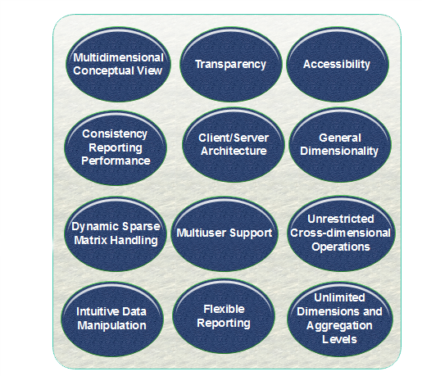
OLAP Guidelines (Dr.E.F.Codd Rule)

Slide 47
Benefits of OLAP
OLAP helps managers in decision-making through the multidimensional record views that it is efficient in providing, thus increasing their productivity.
OLAP functions are self-sufficient owing to the inherent flexibility support to the organized databases.
It facilitates simulation of business models and problems, through extensive management of analysis-capabilities.
In conjunction with data warehouse, OLAP can be used to support a reduction in the application backlog, faster data retrieval, and reduction in query drag.

Slide 48
Data Warehouses
OLAP and data mining databases are frequently stored on special servers called data warehouses:
Can accommodate the huge amount of data generated by OLTP systems
Allow OLAP queries and data mining to be run off-line so as not to impact the performance of OLTP

Slide 49
OLAP, Data Mining, and Analysis
The “A” in OLAP stands for “Analytical”
Many OLAP and Data Mining applications involve sophisticated analysis methods from the fields of mathematics, statistical analysis, and artificial intelligence.
Our main interest is in the database aspects of these fields, not the sophisticated analysis techniques.

Slide 50
Fact Tables
Many OLAP applications are based on a fact table
For example, a supermarket application might be based on a table
Sales (Market_Id, Product_Id, Time_Id, Sales_Amt)
The table can be viewed as multidimensional
Market_Id, Product_Id, Time_Id are the dimensions that represent specific supermarkets, products, and time intervals
Sales_Amt is a function of the other three

Slide 51
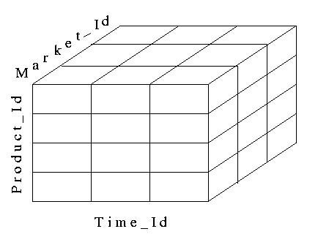
A Data Cube
Fact tables can be viewed as an N-dimensional data cube (3-dimensional in our example)
The entries in the cube are the values for Sales_Amts

Slide 52
Dimension Tables
The dimensions of the fact table are further described with dimension tables
Fact table:
Sales (Market_id, Product_Id, Time_Id, Sales_Amt)
Dimension Tables:
Market (Market_Id, City, State, Region)
Product (Product_Id, Name, Category, Price)
Time (Time_Id, Week, Month, Quarter)

Slide 53
Multidimensional Data
Sales volume as a function of product, month, and region
Dimensions: Product, Location, Time
Hierarchical summarization paths
Region
Industry Region Year
Category Country Quarter
Product City Month Week
Office Day
Product
Month

Slide 54
A Sample Data Cube
Date
Total annual sales
of TV in U.S.A.
1Qtr
2Qtr
3Qtr
4Qtr
sum
Product
TV
PC
U.S.A
VCR
sum
Canada
Country
Mexico
sum
All, All, All

Slide 55
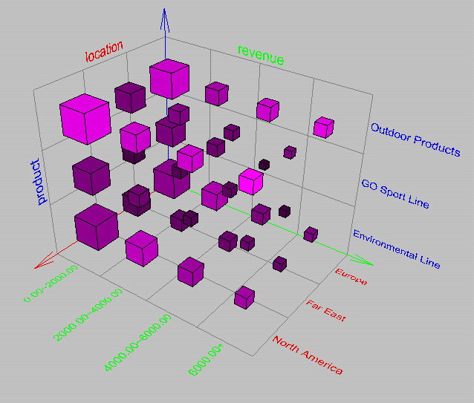
Browsing a Data Cube
Visualization
OLAP capabilities
Interactive manipulation

Slide 56
Typical OLAP Operations
Roll up (drill-up): summarize data
by climbing up hierarchy or by dimension reduction
Drill down (roll down): reverse of roll-up
from higher level summary to lower level summary or detailed data, or introducing new dimensions
Slice and dice: project and select
Pivot (rotate):
reorient the cube, visualization, 3D to series of 2D planes
Other operations
drill across: involving (across) more than one fact table
drill through: through the bottom level of the cube to its back-end relational tables (using SQL)

Slide 57
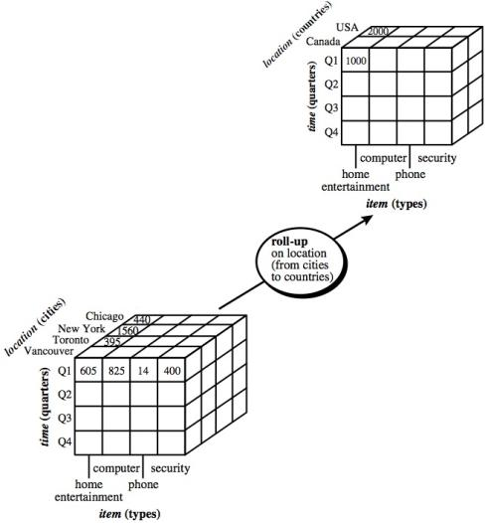
Roll Up

Slide 58
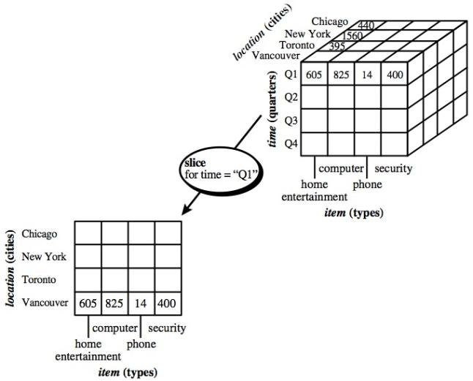
Slice

Slide 59
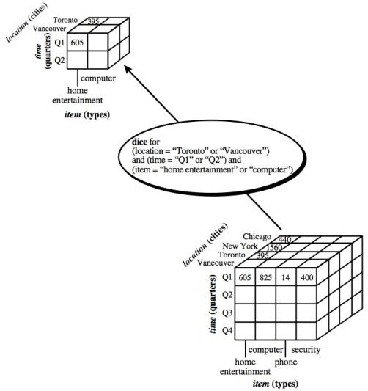
Dice

Slide 60
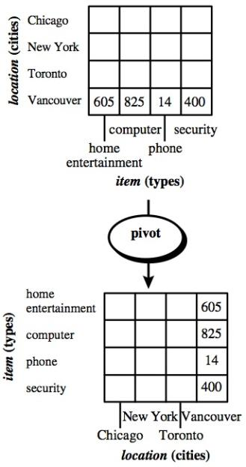
Pivot

